Slide 1
Empirical Analysis of Bank Marketing Success through Machine Learning
A critical reproduction of: ​ “A Data-Driven Approach to Predict the Success of Bank Telemarketing.” ​ By: Moro, Cortez, and Rita (2014) ​ ​ ​ Presented by: Esha Teware and William Shields​ ​ American University | STAT 627 | Fall 2025​

Slide 2
A brief background of the data set
Dataset : Portuguese banking institution.
It captures information from direct marketing campaigns conducted by phone to promote term deposit subscriptions.
Each record represents one client contact, with features describing demographics, financial information, and campaign details
The objective of the campaign was to predict whether a client would subscribe to a term deposit (y).
Paper : “A Data-Driven Approach to Predict the Success of Bank Telemarketing” by Moro, Cortez, and Rita (2014).

Slide 3
Research questions & Goals
Research Question:
Can we accurately predict whether a client will subscribe to a term deposit after a marketing campaign using statistical and machine-learning methods?
Goals:
Replicate Moro et al. (2014)’s methods and results.
Evaluate modern methods from STAT-627 (Ridge, LASSO, LDA, Decision Trees, SVM, Neural Network).
Compare performance across linear and nonlinear approaches using AUC.
Assess interpretability vs. accuracy to recommend the most practical model for bank marketing decisions.
Validate results on hold-out testing data (20 %) to ensure generalization.

Slide 4
Exploratory data analysis
Overview:
41,188 observations and 21 variables (No missing values ) → 10 numeric, 11 categorical (including response y)
Response Variable(y):
Indicates whether the client subscribed to a term deposit (yes / no)
Highly imbalanced: ~88.7% “no”, ~11.3% “yes”
Key Insights:
Numeric variables:
Highly correlated variables: the economic indicators
Excluded variable : “duration”; strongly influences y
Categorical variables:
Most categories : one or two levels
Clients with poutcome = success or contacted in March, October, and December show higher subscription rates.

Slide 5
Implementing machine learning algorithm
Used training set (80%) for model fitting and cross-validation.
Held out 20% testing set for final performance evaluation.
Applied seven supervised classification models
Each model tuned via cross-validation (10-fold CV or equivalent).
Evaluated using AUC and accuracy.
** The original study by Moro et al. (2014) used additional proprietary campaign variables not publicly available in the UCI dataset. Our replication therefore focuses on the variables accessible in the open-source bank-additional-full.csv file.**

Slide 6
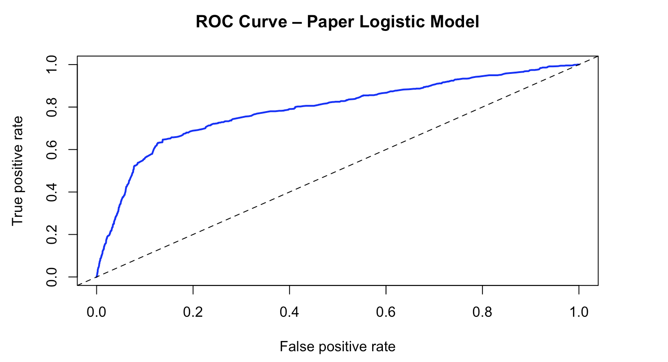
Logistic Regression (Baseline Model)
Fitting:
Replicated the paper’s logistic regression with available predictors: (housing + loan + month + emp_var_rate + euribor3m + cons_conf_idx + nr_employed)
Fitted the model on 80 % training set
Performance:
AUC ≈ 0.789 (baseline)
Confusion matrix shows under-prediction of yes class.

Slide 7
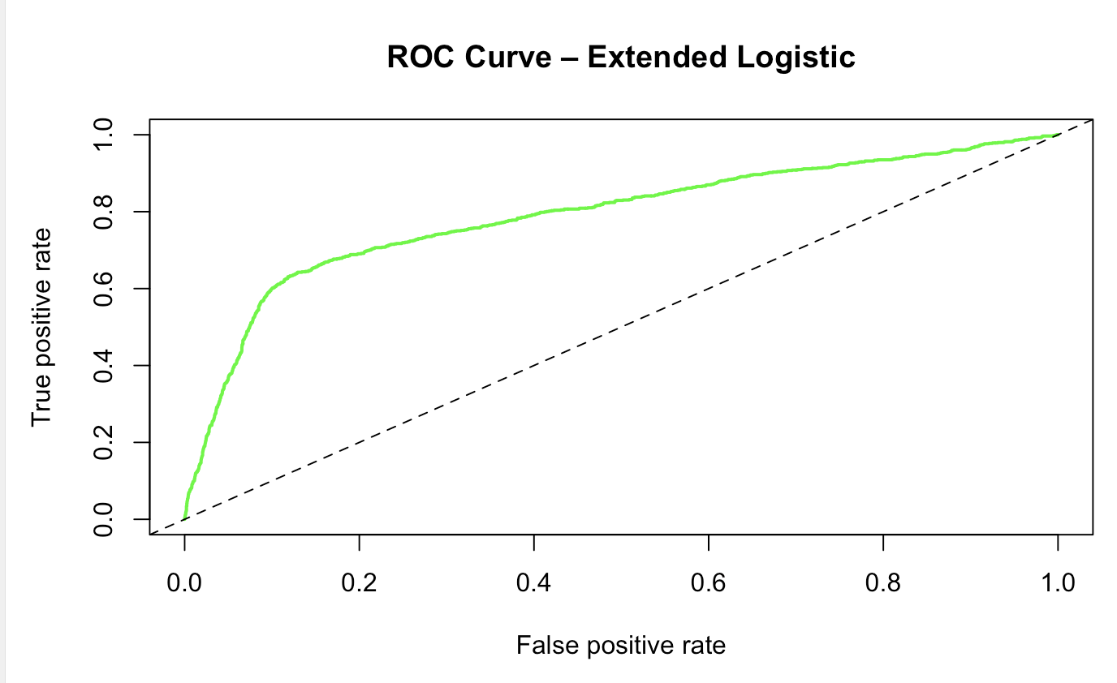
Logistic Regression (Extended Model)
Broaden beyond macro-economic signals: added client profile & campaign history.
New inputs:
job, marital status, education, campaign count & weekday, existing housing/loan flags (original economic terms)
Performance:
AUC ≈ 0.789 (virtually identical to baseline)
Take-away:
More predictors introduced multicollinearity and noise; model is wider but not better.

Slide 8
Regularized Logistic Regression Models
Fitting the Models:
Applied Ridge (L2) and LASSO (L1) logistic regression.
Added penalty λ to shrink coefficients & reduce overfitting.
Tuning:
Used 10-fold Cross-Validation (on training data to select the best penalty λ).
Performance:
Lifts AUC by ≈ 0.01 vs. the extended logistic, but still below the 0.90 reported in Moro et al. likely due to omitted proprietary predictors.
Model | Type | Best λ | AUC (on test) | Key Insight
Ridge | Regularized (L2) | 0.011 | 0.796 | Handles multicollinearity, smooths coefficients
LASSO | Regularized (L1) | 0.00018 | 0.798 | Performs feature selection, interpretable model

Slide 9
Tree-Based Models & Random Forest
Single Decision Tree:
Struggled with class imbalance (89% "No").
Achieved AUC: 0.769.
Random Forest (Best Model):
Removed emphasis on only a few predictors.
Achieved AUC: 0.802 (Top Performer).
Stable: Test Error (10.28%) ≈ OOB Error (10.19%).
Key Insight:
While the paper cites Employment Rate (nr.employed) as a critical predictor, our Random Forest ranked it as the least important variable.

Slide 10
Linear Discriminant Analysis (LDA)
Fitting the Model:
Implemented a simple LDA model to determine effectiveness of a generative classification over discriminant logistic model.
Produces a linear decision boundary that separates the “yes” and “no” classes based on maximum separation of class means.
Performance:
Accuracy: 89% (Misleading), matches the dataset’s baseline "No" rate almost exactly.
The AUC : ~0.79 aligns perfectly with Logistic Regression and Ridge/Lasso.
Detected severe Multicollinearity.

Slide 11
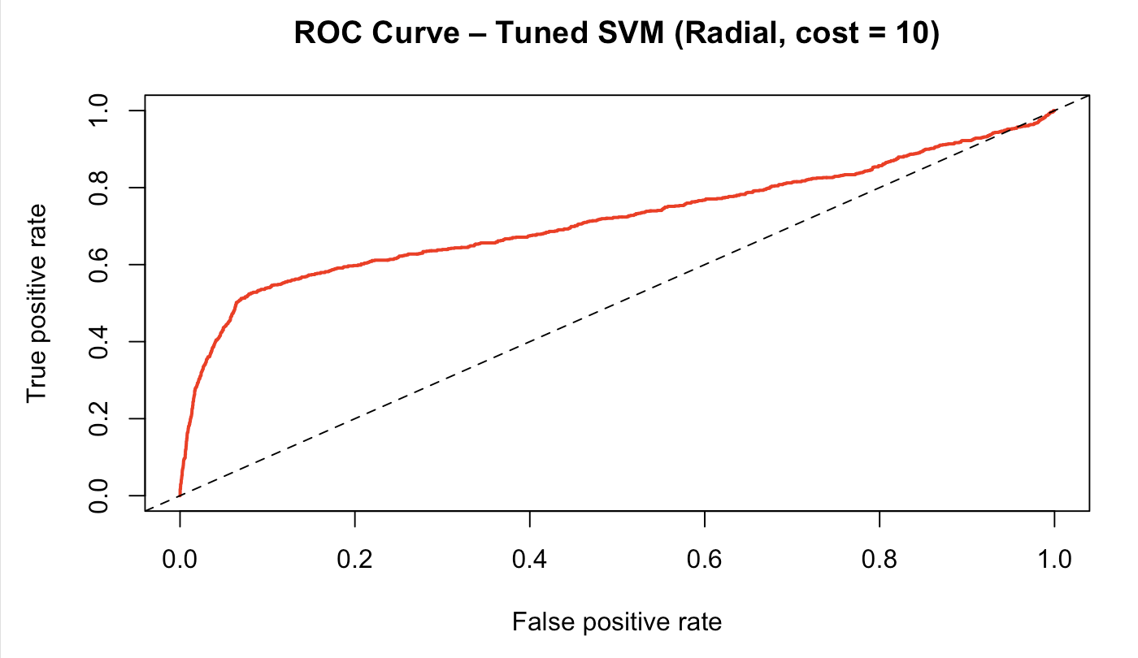
Support Vector Machine (SVM)
Fitting the Model:
Initial model (Linear kernel): Struggled with data distribution.
AUC: 0.638 (poor performance)
The model biased toward majority class (“No”), failing to identify subscribers
Tuning:
10-fold cross-validation on a 5K observation subset for efficiency.
Best: Radial, cost = 10, CV error ≈ 0.10.
Performance:
AUC = 0.72 on test set.
Slight improvement in non-linear flexibility; performance worse than Ridge/LASSO.

Slide 12
Neural Network (Feed-Forward Model)
Fitting the Model:
Implemented standard feed-forward network with 1 hidden layer (5 nodes)
Input features standardized (scaling critical for stable convergence).
Tuning:
Tested Hidden-layer size (1- 5 nodes) and decay parameter (0.0001 – 0.01)
Selected size = 5 and decay = 0.001 after cross-validation for best bias-variance trade-off.
Performance:
AUC = 0.79, consistent with logistic regression (vs. 0.91–0.93 reported in Moro et al., 2014)
Indicates limited nonlinearity - patterns largely linearly separable.
Confirms that adding a hidden layer offers marginal gain over simpler models.

Slide 13
Testing on Hold-Out Data & Generalization
20 % of data held out before fitting/tuning.
Models demonstrated no overfitting.
The models are robust and stable.
Best AUC on Hold-out Data: 0.802 (Random Forest)

Slide 14
Comparing Model Performance: Hold-Out Test Data
Model | Type / Approach | Key Tuning Parameter(s) | RMSE | AUC (on Test Data) | Interpretation
Logistic Regression (Paper replication) | Linear baseline | None | 0.2859 | 0.789 | Baseline accuracy matching paper
Logistic Regression (Extended) | Linear (additional predictors) | None | 0.2849 | 0.790 | Minimal gain over baseline; suggests redundant variables.
Ridge Regression | Regularized (L2) | λ = 0.011 | 0.2799 | 0.796 | Stabilizes coefficients; mitigates multicollinearity.
LASSO Regression | Regularized (L1) | λ = 0.00018 | 0.2788 | 0.798 | Best linear performer
Linear Discriminant Analysis (LDA) | Generative linear | None | 0.2922 | 0.796 | Performs identically to Logistic Regression; confirms "Linear Ceiling" of ~0.80.
Decision Tree (Extended) | Non-parametric | cp (CV tuned) | 0.2825 | 0.769 | Simple but less flexible; limited by class imbalance.
Random Forest | Ensemble (bagged trees) | ntree = 500 | 0.2787 | 0.802 | Overall Winner. Lowest error (RMSE) and high AUC. Captures non-linearities.
Support Vector Machine | Margin-based (Radial kernel) | cost = 10 | 0.2915 | 0.715 | Underperformed. Heavily impacted by class imbalance (89% "No").
Neural Network | Non-linear feed-forward | size = 5 | 0.2809 | 0.790 | Matched Logistic Regression; failed to beat Random Forest on this split.

Slide 15
Summary of Findings
Yes, prediction is viable: We successfully built a predictive model using only pre-call data.
Best Model: Random Forest
• The Random Forest achieved an AUC of 0.802, demonstrating that we can identify likely subscribers with high probability even without knowing call length.
• Stability: The model showed excellent generalization with no overfitting (Test Error ≈Training Error).
Linear Models & Stability:
• Ridge & LASSO were crucial for identifying multicollinearity (redundancy between Euribor and Employment Rate)
Replication Result:
• Divergence from Paper: Our replication found Tree based Ensembles (Random Forest) to be the superior approach while paper favored Neural Networks.
• Linear Ceiling: All linear models (Logistic, Ridge, LDA) hit a "performance ceiling" at ~0.79 AUC, confirming the relationship is non-linear.

Slide 16
Pros and Cons of analysis and the models
Pros (Strengths):
Validated Hypothesis: Confirmed Interest Rates are the primary driver of client decisions.
Realistic Success: Achieved AUC 0.802 with a Random Forest model.
Efficiency Found: Proved Employment Rate is redundant; Interest Rate alone is sufficient.
Cons (Limitations):
Class Imbalance: SVM struggled (AUC 0.715) due to the 89% "No" rate.
Linear Ceiling: All linear models plateaued at AUC ~0.79, failing to capture complex patterns.
Black Box: Random Forest offers high accuracy but less interpretability than other models.

Slide 17
Future Work
Add more information:
Bring in extra customer history and new economic numbers to give the model better clues.
Balance the classes:
Adjust the training data so “yes” and “no” cases are closer in number- helps the model notice the rarer “yes” group.
Refine decision threshold:
Test different cut-off points to pick the spot that gives the best marketing payoff.
Track and explain the model:
Keep a simple dashboard of key metrics (AUC, error rate) and record the top factors driving each prediction so results stay transparent over time.

Slide 18

Thank you

Slide 19
Appendix (KNN )
Model Setup:
Implemented using class::knn() on scaled numeric predictors.
Evaluated for k = {3, 5, 7, 9, 11} using 80/20 train-test split.
Best-performing value: k = 11.
Performance:
Accuracy (train/test): ~89.4% at k = 11.
AUC: 0.618 (lowest among tested models).
Model heavily biased toward the majority “no” class due to imbalance.
Interpretation:
Performs adequately in raw accuracy but poor at ranking probabilities (low AUC).
Confirms that KNN struggles in high-dimensional, imbalanced datasets.
Retained for completeness — not competitive with regularized or ensemble methods.

